Slide 1
GitHub Guide

Slide 2
Git Terminology $git help
Command Line: The program to input Git commands.
Mac: Terminal.
PC: Command Prompt, yet Cygwin Terminal works better than the default program.
Repository (Repo): A directory or storage for your projects. You can keep code files, text files, image files,etc, inside a repository.
Version Control: with Git, you don’t need to save multiple versions to keep track of changes. It keeps “snapshots” of every point in time in the project’s history, so you can never lose or overwrite it.
Branch: This allows many people to work on the same project at the same time without interrupting each other’s work. After they’re done, they can “merge” that branch back to the “master,” the main directory of the project.

Slide 3
clone: A clone of a repository ("just another repository")
commit: A state of your project at a certain time. Contains a pointer to its parent commit (in case of a merge: multiple parents) and a pointer to the directory structure at this point in time.
tree: Basically a directory. It's just a list of files (blobs) and subdirectories (trees). (The list may also contain commits in case you use submodules, but that's an advanced topic)
upstream: After cloning a repository you often call that "original" repository "upstream". In git it's aliased to origin
a head: The top commit of a branch (commit the label points to)
HEAD: A symbolic name to describe the currently checked out commit. Often the topmost commit
version: Might be the same as a commit. Could also mean a released version of your project.
tag: A descriptive name given to one of your commits (or trees, or blobs). Can also contain a message (eg. changelog). Tags can be cryptographically signed with GPG.
https://www.kernel.org/pub/software/scm/git/docs/gitglossary.html

Slide 4
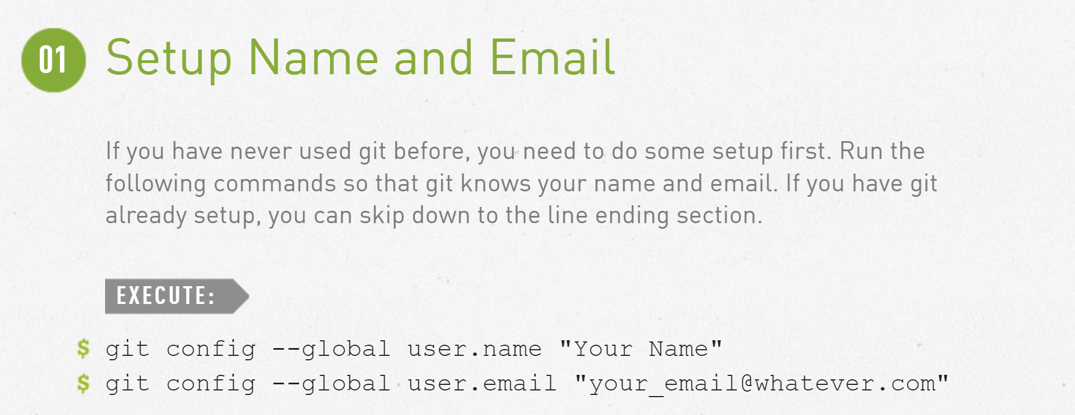
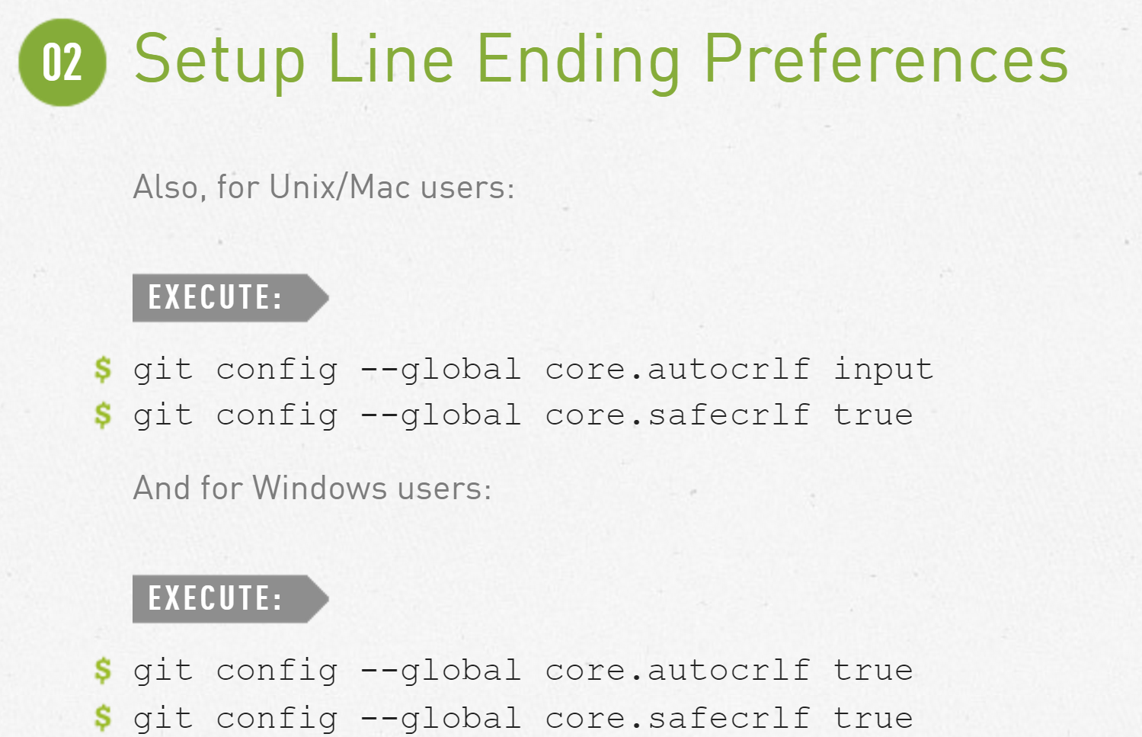
Setup

Slide 5
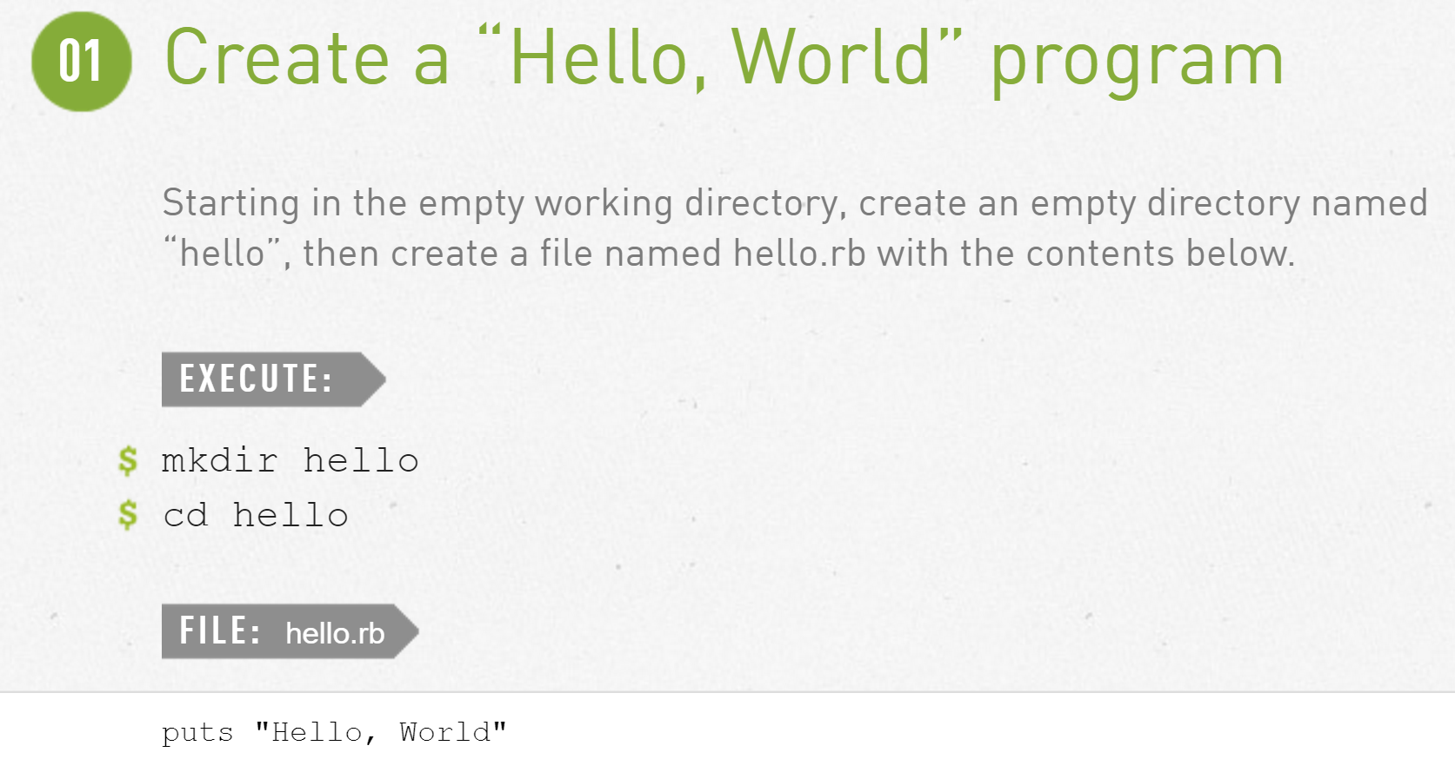
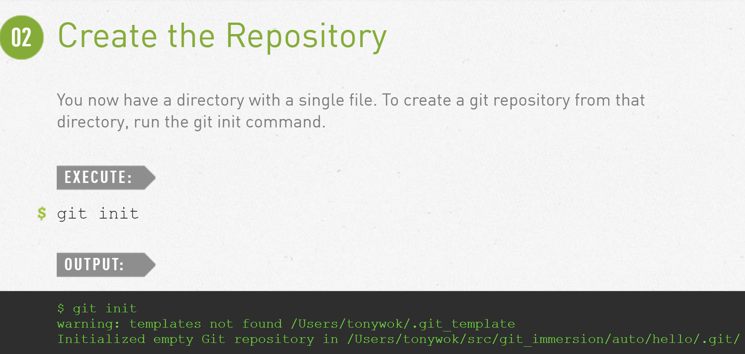
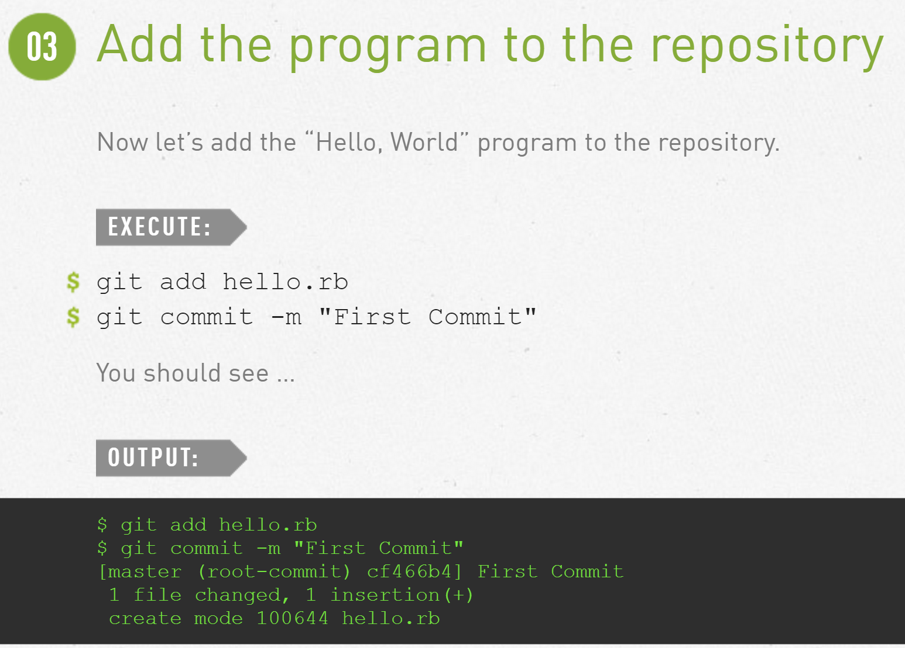
Create a Git Repository

Slide 6
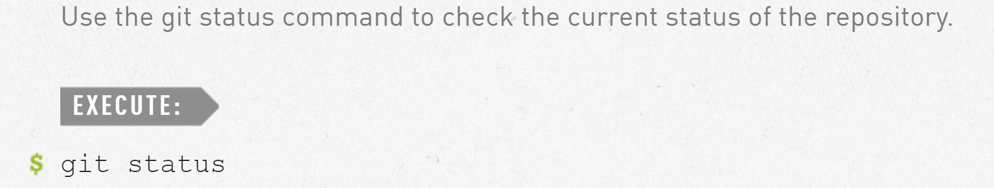
Check Repo Status

Slide 7
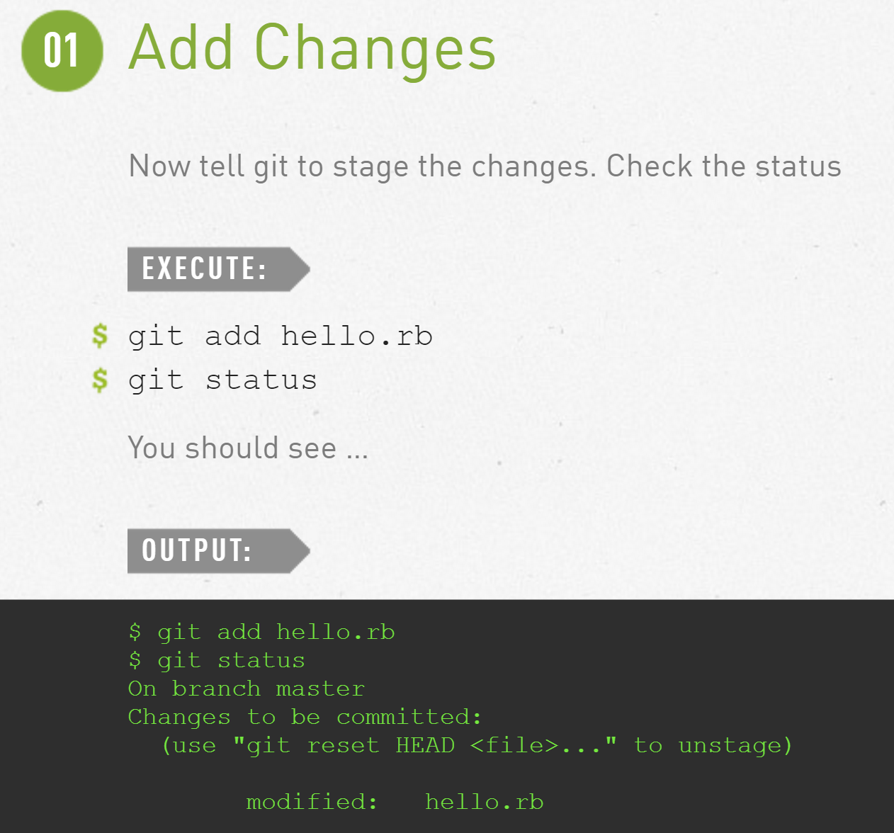
Staging changes for later commits
The change to the hello.rb file has been staged. This means that git now knows about the change, but the change hasn’t been permanently recorded in the repository yet. The next commit operation will include the staged changes.
If you decide you don’t want to commit that change after all, the status command reminds you that the git reset command can be used to unstage that change.

Slide 8
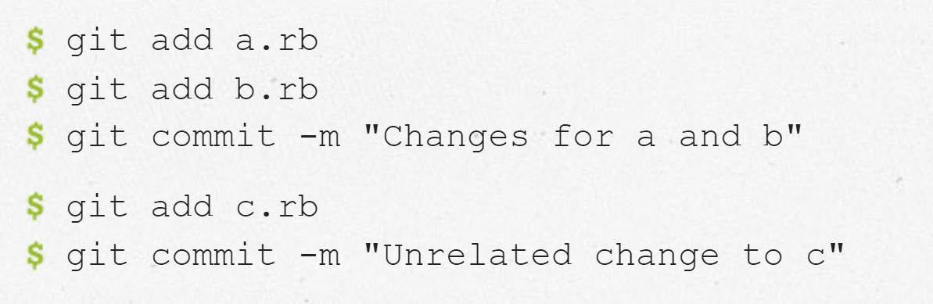
Staging and Committing
A separate staging step in git is in line with the philosophy of getting out of the way until you need to deal with source control. You can continue to make changes to your working directory, and then at the point you want to interact with source control, git allows you to record your changes in small commits that record exactly what you did.
- For example, suppose you edited three files (a.rb, b.rb, and c.rb). Now you want to commit all the changes, but you want the changes in a.rb and b.rb to be a single commit, while the changes to c.rb are not logically related to the first two files and should be a separate commit.
-m flag is included in the commit command to allow you to interactively edit a comment for the commit.
If you omit the -m flag from the command line, git will pop you into the editor of your choice. The editor is chosen from the following list (in priority order):
GIT_EDITOR environment variable
core.editor configuration setting
VISUAL environment variable
EDITOR environment variable

Slide 9

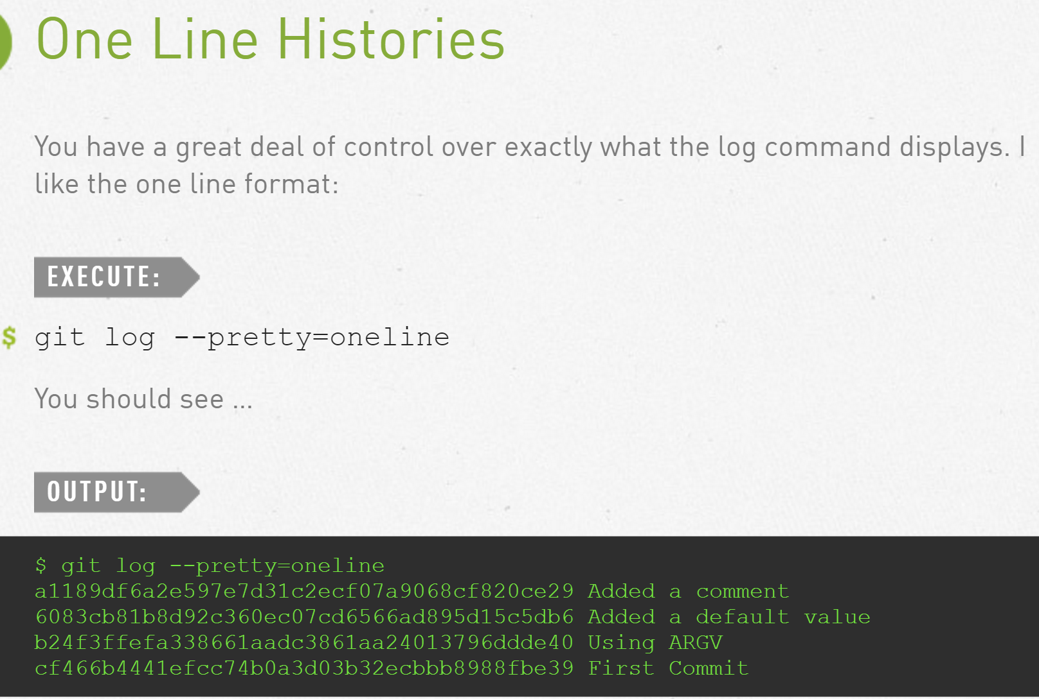
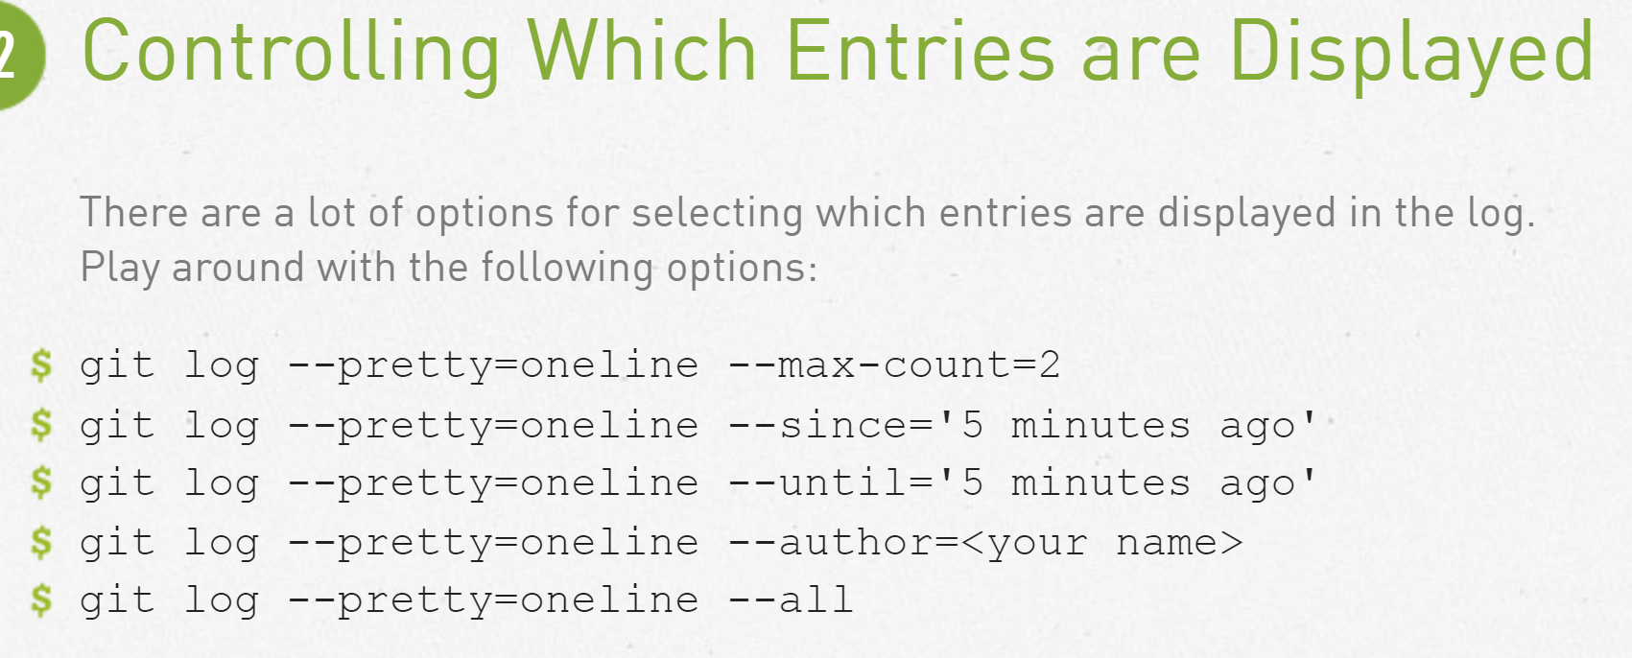
History

Slide 10
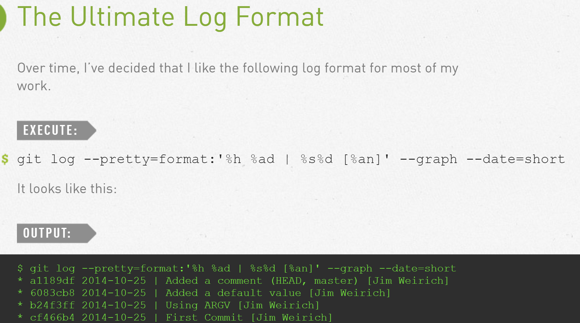
--pretty="..." defines the format of the output.
%h is the abbreviated hash of the commit
%d are any decorations on that commit (e.g. branch heads or tags)
%ad is the author date
%s is the comment
%an is the author name
--graph informs git to display the commit tree in an ASCII graph layout
--date=short keeps the date format nice and short

Slide 11
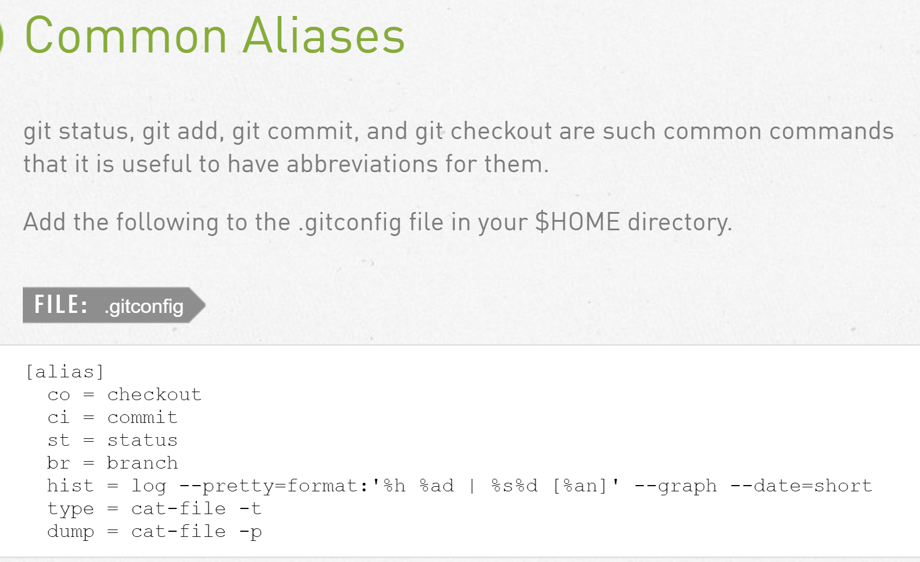
Aliases

Slide 12
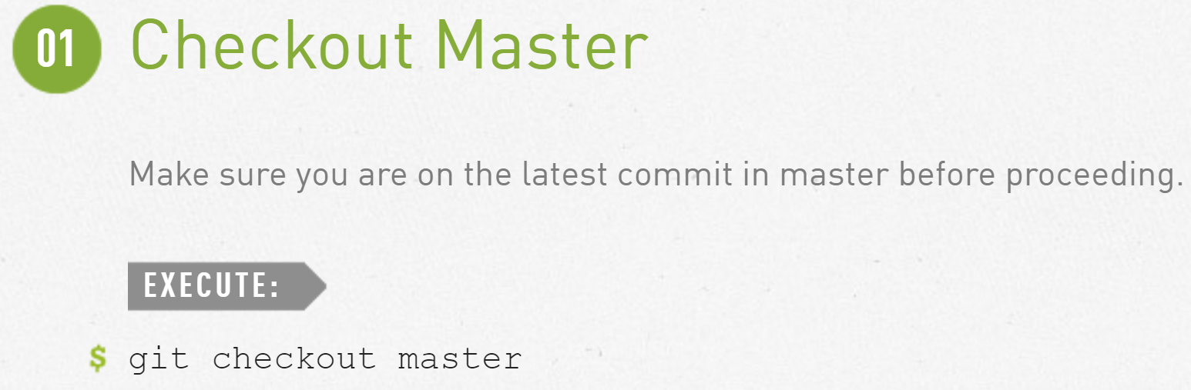
Undo local changes before staging

Slide 13
The status command shows us that there are no outstanding changes in the working directory. And the “bad comment” is no longer part of the file contents.
We see that the hello.rb file has been modified, but hasn’t been staged yet.

Slide 14
Undo Staged changes before committing
The reset command resets the staging area to be whatever is in HEAD. This clears the staging area of the change we just staged.
The reset command (by default) doesn’t change the working directory. So the working directory still has the unwanted comment in it. We can use the checkout command to remove the unwanted change from the working directory.

Slide 15
Amend commits

Slide 16
Moving files within a repo
We inform git of 2 things:
That the file hello.rb has been deleted.
The file lib/hello.rb has been created.
Both of these bits of information are immediately staged and ready to be committed. The git status command reports that the file has been moved.

Slide 17
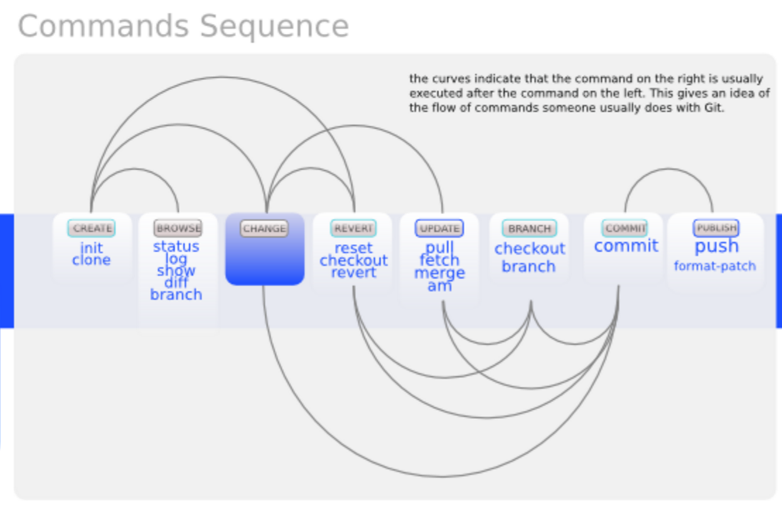

Slide 18
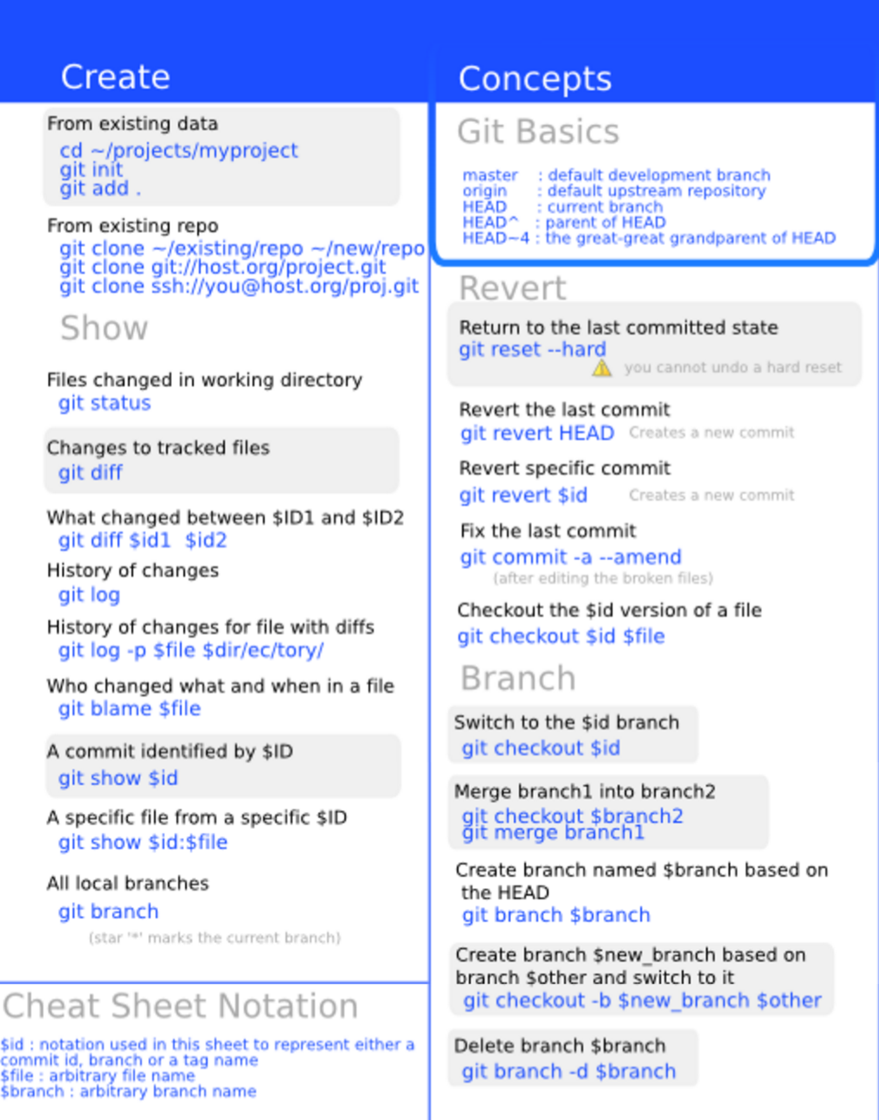

Slide 19
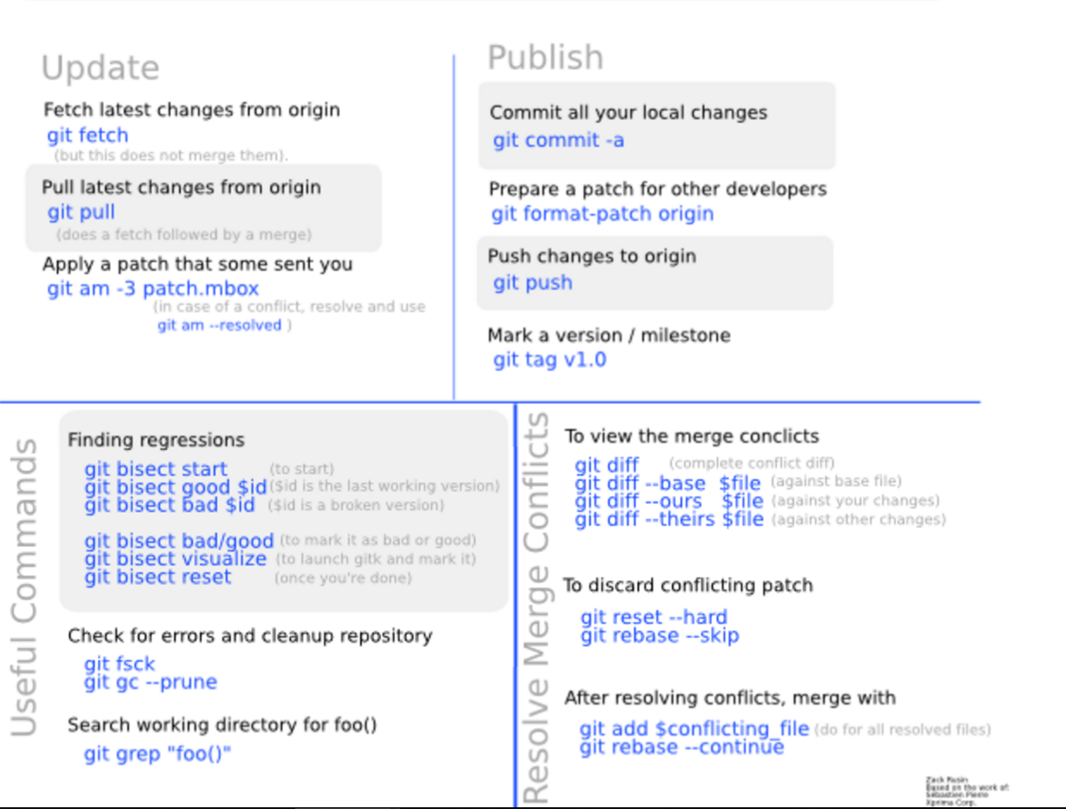

Slide 20
Reference
http://rogerdudler.github.io/git-guide/
http://readwrite.com/2013/09/30/understanding-github-a-journey-for-beginners-part-1/
http://stackoverflow.com/questions/7076164/terminology-used-by-git
http://gitimmersion.com/
http://byte.kde.org/~zrusin/git/git-cheat-sheet-medium.png
https://git-scm.com/book/en/v2

